Slide 1

Diwali Sales Data Analysis Using Python
Arnab Samanta
17-07-2024

Slide 2

OUTLINE
Introduction
Methodology
Results
Visualization-charts
Discussion
Findings
Conclusion

Slide 3

Introduction
About:
Diwali Sales Data Analysis
Objective:
Analyse The Sales Data
Make Some Insightful Comments On Sales By Observing The Data

Slide 4

Methodology
Business Problem Understanding
Data Collection
Client has provided historical data in csv file
Link: https://drive.google.com/file/d/1mGY1doT8RRTgIS0eZsiexHOjUIel9pvo/view?usp=drive_link
Data Pre-processing
Data Profiling
Data Cleaning
Data Consistency
Data Formatting
Outlier Detection & Removal
Exploratory Data Analysis

Slide 5
Results
Visualization (charts)
Gender wise Sales Analysis - page 6
Marriage Status Wise Sales Analysis - page 7
Age Group Wise Sales Analysis - page 8
Occupation Wise Sales Analysis - page 9
Product Category Wise Sales Analysis - page 10
Product ID Wise Sales Analysis - page 11
State Wise Sales Analysis - page 12

Slide 6
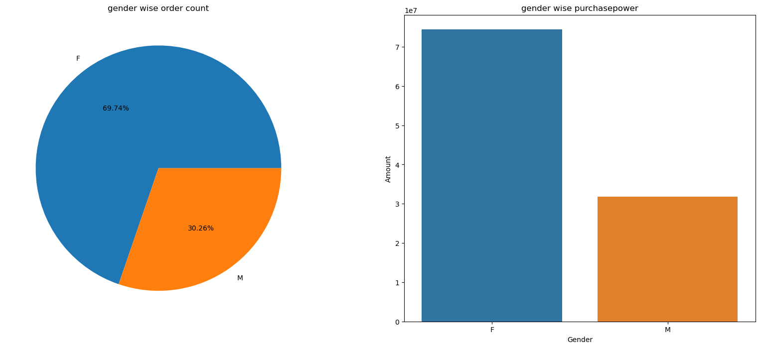
Gender wise Sales Analysis
Female Generally Places More Order Compare to Male

Slide 7
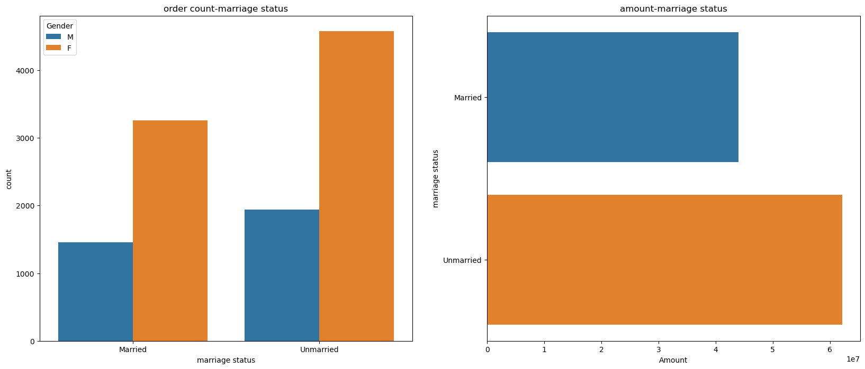
Marriage Status Wise Sales Analysis
Unmarried Females Are Spending More Compare To Married Females And Males

Slide 8
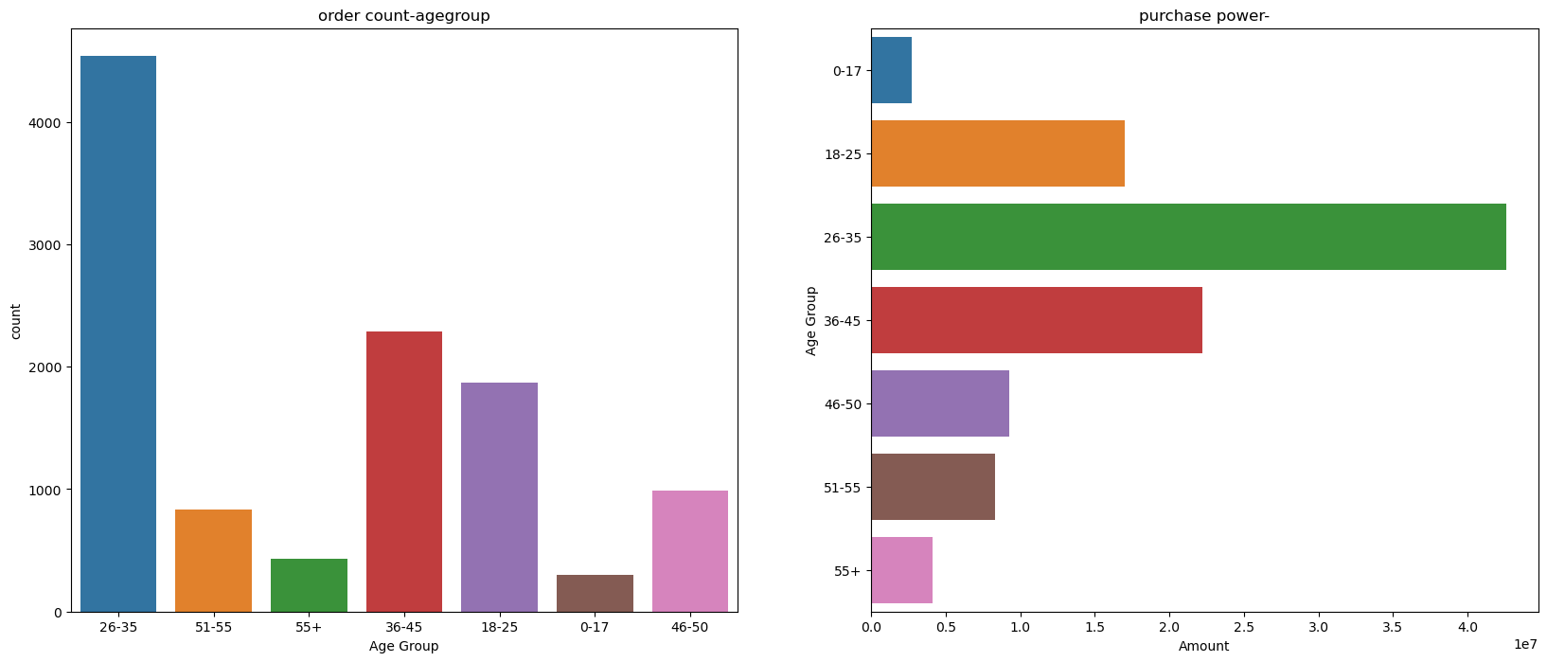
Age Group Wise Sales Analysis
26-35 Age Group People Buy More Compare To Other Age Groups

Slide 9
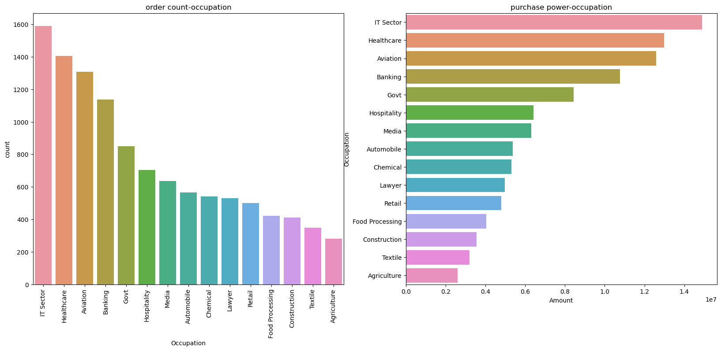
Occupation Wise Sales Analysis
IT Sector's People Order More And Pay More Amount Than Other Occupations

Slide 10
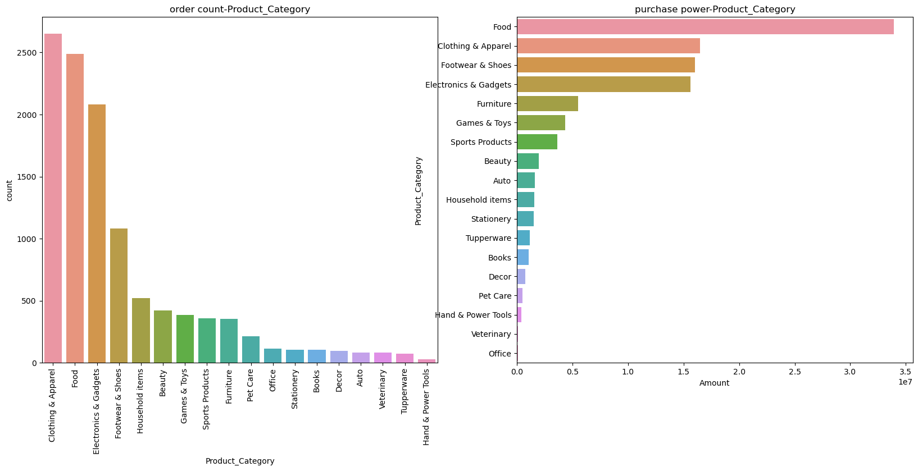
Product Category Wise Sales Analysis
The Food category generates the highest revenue despite a lower order count, compared to Clothing & Apparel, which leads in order count but not in total amount spent

Slide 11
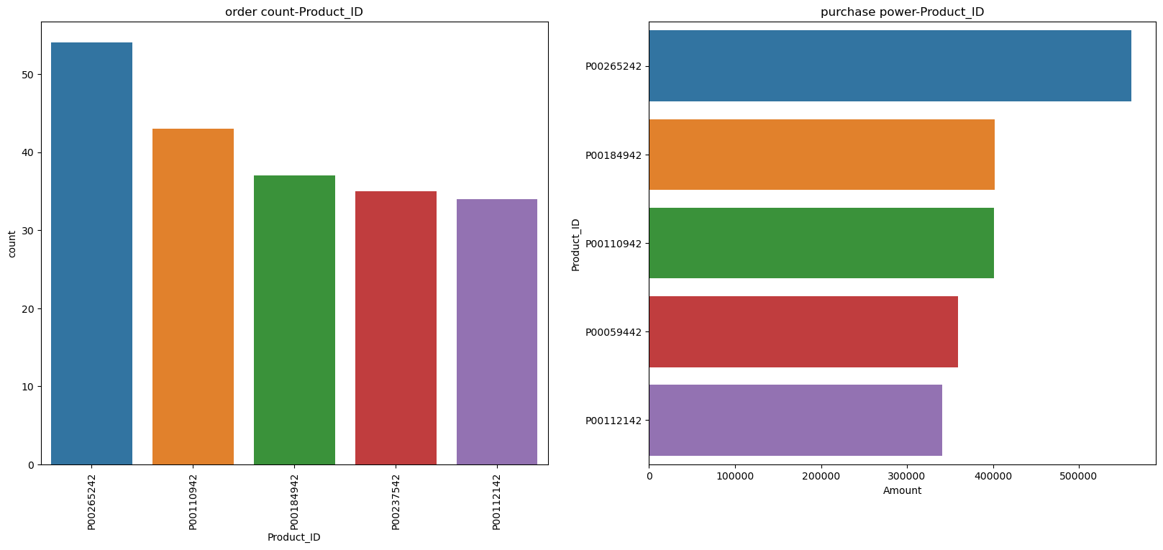
Product ID Wise Sales Analysis
Product ID P00265242 is the top performer in both order count and total amount spent

Slide 12
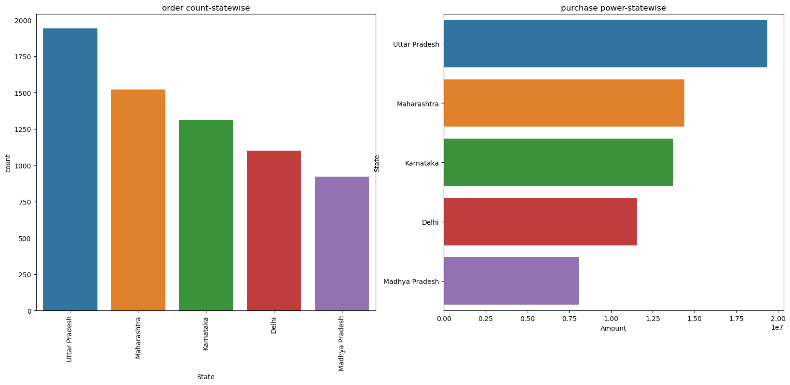
State Wise Sales Analysis
Uttar Pradesh and Maharashtra are the top states in terms of order count and total amount spent

Slide 13
Discussion
Findings:
Female Generally Places More Order Compare to Male
Unmarried Females Are Spending More Compare To Married Females And Males
26-35 Age Group People Buy More Compare To Other Age Groups
IT Sector's People Order More And Pay More Amount Than Other Occupations
The Food category generates the highest revenue despite a lower order count, compared to Clothing & Apparel, which leads in order count but not in total amount spent.
Product ID P00265242 is the top performer in both order count and total amount spent.
Uttar Pradesh and Maharashtra are the top states in terms of order count and total amount spent.

Slide 14
Conclusion:
Young adult women aged 26-35 shop the most, while unmarried women outspend both married women and men. The IT sector displays higher shopping frequency and expenditure, potentially due to higher incomes. Client can increase this by offering tech-related products or exclusive deals to this audience. Food items yield more revenue per purchase despite lower order volume compared to clothes. . Client should optimize product mix and pricing strategies across categories to maximize revenue and profitability. Product ID P00265242 excels in both sales volume and revenue, suggesting a successful model for other products. Uttar Pradesh and Maharashtra emerge as robust consumer markets.
Businesses can leverage these insights to optimize product offerings and marketing strategies for enhanced profitability and customer satisfaction across diverse demographics and regions.

